Slide 1


Auxilio Robotics
Propelling Assistive Healthcare Into the Future
Standards and Regulations

Slide 2
Safety requirements for personal care robots
ISO 13482:2014

Slide 3
What is the standard about? (ISO 13482:2014)
Guidelines to prevent potential risks of robot hardware to person in environment.
It does so by following broad umbrella considerations like:
Robot mechanical and electrical properties
HRI
Functional Safety
Robot Behavior
Documentation and Information
Verification and Validation

Slide 4
Products & Markets (ISO 13482:2014)
Robots that are designed to help individuals in multiple ways:
Helping with daily tasks
Mobility support
Medical assistance
This is a broad market ranging from very hands-on robots like Whill Model Ci wheelchair to very hands-off robots like Delivery robots inside hospitals or nursing homes.
Note: NOT disease/ illness specific robots. (Could be used for about anybody)

Slide 5
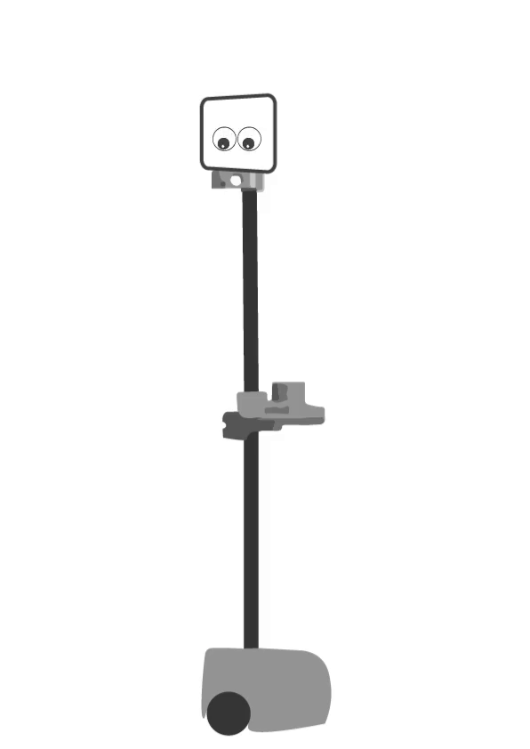
Main Prescriptions (ISO 13482:2014)
Localization accuracy so that doesn’t get too close to staircases
Object identification so that a glass of hot water isn’t delivered when cold was requested
Physical design:
Eliminate sharp edges
Acceptable degree of error:
Human in vicinity
The chances of being hit by me are less..
But never Zero!

Slide 6
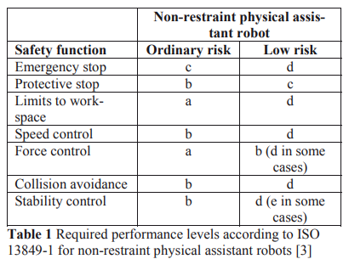
Main Prescriptions (ISO 13482:2014)
Documented risk
List of “Do not” to address cases where the robot may not cooperate
Correlate to not putting Bleach in your eyes, not mouth
Operability: Reduced speed, force, axes of freedom
d > a
b - size is already small
e - risk fairly imminent so harder reqs

Slide 7
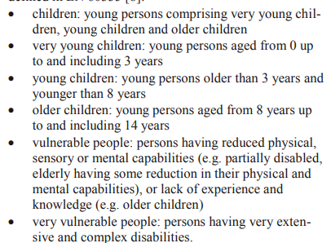
Main Prescriptions (ISO 13482:2014)
Work on Intended Contact
German Healthy Adults
Call for a broader study range
Validation and Verification
Dummy on robot and in environment
Test
Inspection
Practical test
Measurement
Observation of Behavior (with payload)

Slide 8
Application to (ISO 13482:2014)
Physical design is way too light and has no sharp edges
Electrical assembly is very-well insulated
Base and wrist completely covered
Max joint value trigger
You can push it back
Killswitch (e-stop)
Limited speed and force
Documentation
Stretch RE1 Best Practices Unpowered - YouTube
Arm up robot transport in car
Tool shouldn’t be touching base as support
Only moderate external forces while repositioning
Safety Guide - Stretch Documentation (hello-robot.com)
Can topple
Shouldn’t be lifted by a single person
Has laceration potential because sharp
Flammable
Electrical device
Stretch RE1 Best Practices Powered - YouTube
Home
Stow

Slide 9
Trustworthiness in AI
ISO/IEC TR 24028:2020

Slide 10
What is it about? (TR 24028:2020)
Overview of trustworthiness in AI applications
Approaches
Transparency
Explainability
Controllability
Engineering pitfalls and threats/risks with mitigation techniques
Approaches to assess & achieve reliability, accuracy, resiliency, safety, security and privacy, fairness.
1) Building trustworthiness in technical systems 2) Identification and definition of stakeholders 3) Responsibility, accountability, governance, and safety of AI systems 4) Vulnerabilities of AI systems 5)Mitigating vulnerabilities: controllability, transparency, data handling, robustness, testing, evaluation, and use

Slide 11
What is it about? (TR 24028:2020)
1) Building trustworthiness in technical systems
2) Identification and definition of stakeholders
3) Responsibility, accountability, governance, and safety of AI systems
4) Vulnerabilities of AI systems
5) Mitigating vulnerabilities: Controllability, transparency, data handling, robustness, testing, evaluation, and use

Slide 12
Products & Markets (TR 24028:2020)
Any system (product/service) that uses Artificial Intelligence.
AI - Capability of an engineered system to acquire, process and apply skills
People:
AI users, developers, testers, organizations, annotators etc
Products:
Personal Assistants,
Chatbots
Recommendation systems,
Robots
Internet of Things, Smart Appliances

Slide 13
Relevant Items (TR 24028:2020)
Security
Data poisoning
Adversarial Attacks
Model Stealing
Hardware attacks
Privacy
Data acquisition
Data pre-processing & modelling
Model querying
Implementation
Data processing
Feature engineering
Hyperparameter optimization
Model updation
Use
Misuse
Abuse
Bias, stochasticity, non-explainability

Slide 14
Main Prescription(TR 24028:2020)
Transparency
Use rating symbols, icons/marks to help children/parents understand AI easily.
This could involve providing simple explanations of how the system works, or offering detailed explanations
Transparency about data source, training methodology, parameterization (OSS models)
Explainability
Understanding of how result is obtained (causal/epistemic/justificatory)
Could be through AI system itself producing explanation / system itself is explainable
Post-modelling stage is explaining the unexplainable system
Evaluation for explanations
Continuity - explanation of nearby points should be roughly same
Consistency - importance score of a feature does not decrease if model input changes a lot
Selectivity - importance based explanations are such that contributions are distributed

Slide 15
Main Prescription(TR 24028:2020)
Controllability
Human in the loop control points
Decision makers have autonomy in decision maker process (e.g., early chess AIs)
Domain experts can give feedback to re-assess level of trust of the system
Bias
Consider legal requirements when setting system requirements
Analysis of data sources
Technical techniques
Trials/operational reviews can be done
Privacy
Technical methods to de-identify data before it is provided to model.
Hardware Faults
Redundancies & fail-safe hardware techniques. [Source]

Slide 16
Main Prescription(TR 24028:2020)
Testing and Evaluation
Software Verification and Validation
Technical methods to evaluate uncertainty, stability
Testing w.r.t, human performance
Testing in simulation
Expectation management
Product labelling
Cognitive science research for HCI interaction

Slide 17
Application to (TR 24028:2020)
Alfred uses an RGBD camera for world perception.
Ensure that the data sources are open source, de-identified, and bias free
Trained on open source data that has been vetted over several years.
Data security & Privacy
All image data is stored locally, and is not exposed to online systems
We test our systems thoroughly in simulation prior to deploying on real hardware.
Stakeholders (external) are well aware of system capabilities
We could perform HRI studies after deploying the robot for use in a facility.

Slide 18
References
Information technology — Artificial intelligence — Overview of trustworthiness in artificial intelligence (ISO-IEC-TR-24028-2020.pdf (iteh.ai))
T. Jacobs and G. S. Virk, "ISO 13482 - The new safety standard for personal care robots," ISR/Robotik 2014; 41st International Symposium on Robotics, Munich, Germany, 2014, pp. 1-6.
TeamB_Stds&Regs.pdf @ 2021
TeamH @ 2020

Slide 19




👍
Hey Alfred, get me an apple
@auxiliorobotics

